Slide 1
Aux P.S layout consideration
Lior Maor

Slide 2
Agenda
Aux power range + Loads
Background
Flyback switching
Guidelines
Examples:
  AP1999B portia X
  AP2290A Neptune main board
  AP2214BA main board Jupiter 3
  AP1391CA Orion Digital board
  AP1163FB Jupiter + Improved DC board
  AP1551C Aux board Orion

Slide 3
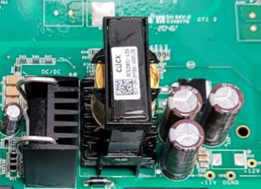
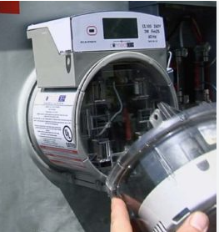
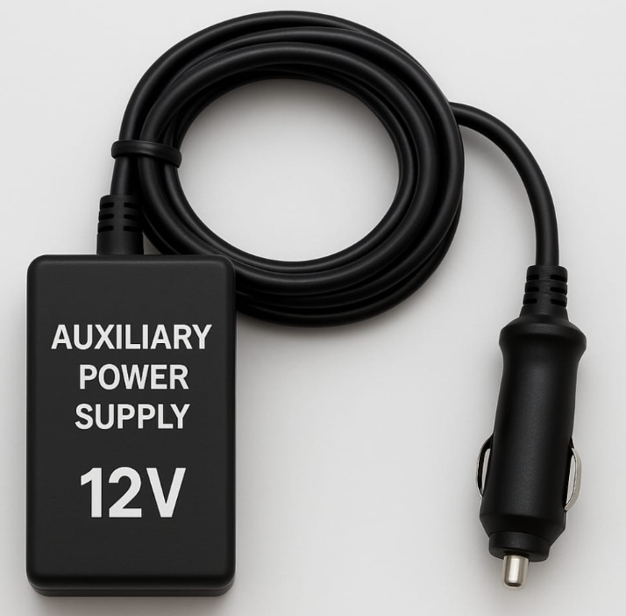
Aux power supplies
Aux Power supplies have variant power from 1W to 300W
Aux from AC or DC power inputs are Isolated P.S
Aux power can supply also to different PCB’s or External devices
such as meter collar
Aux Loads is used for:
High Loads: Relays and Fans: 12V, 24V
Digital systems: DSP, FPGA, Flash, Logic gates, etc’: 5V, 3.3V, 1.8V, 1.2V
Analog voltages A/D, current sense, opamp. Usually create it by filtering Digital voltage
Gate drivers Isolated Power supply can be from 12V to 18V or 21V.

Slide 4
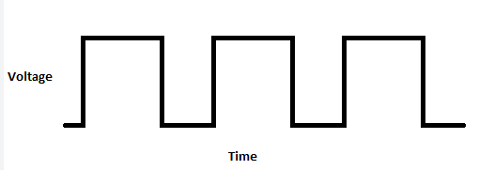
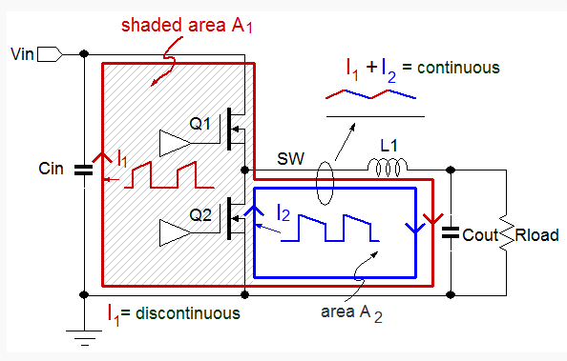
background
High dV/dt
Minimize current loop discontinues current at the FET and diode

Slide 5
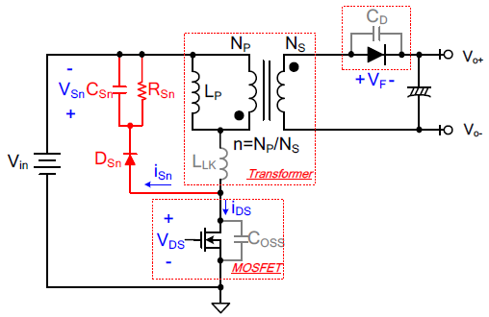
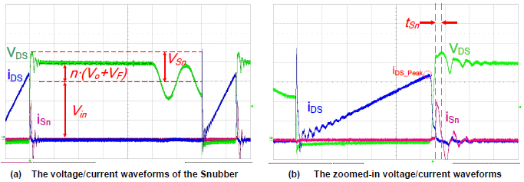
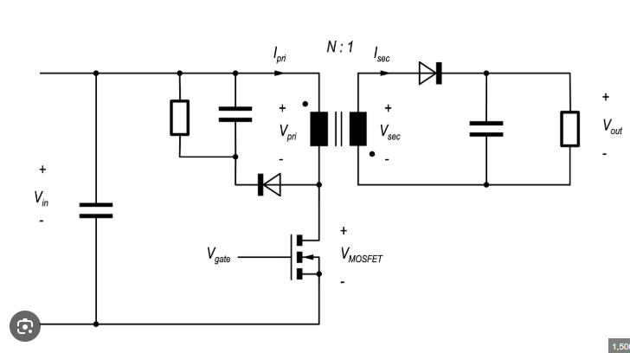
Flyback
Initial current spike due to dI/dt of leakage inductance
SW node di/dt is changing
Make current loop as small as possible
Off time
on time

Slide 6
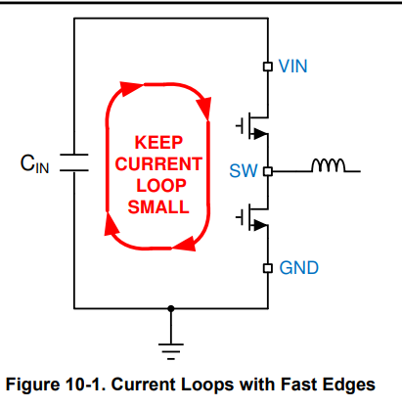
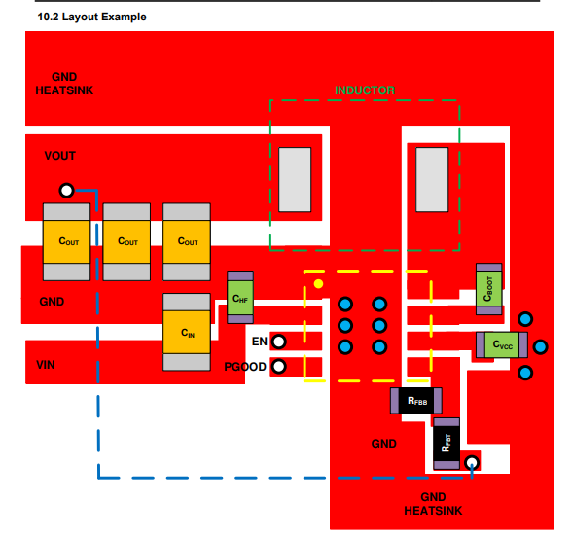
Guidelines
The input capacitor (Buck) and output capacitor (Boost) must be placed as close to the device as possible to minimize trace impedance.
  The GND trace between the Input/output capacitor and the GND pin must be as wide as possible to minimize its trace impedance.
Place the feedback divider as close as possible to the FB pin of the device
  Route the separate FB from Vo to the sense resistor away from the switching node
  The trace of the VFB node must be as small as possible to avoid noise coupling.
Keep continues ground plane below P.S (if components are at CS, the ground will be in L2)
Keep High di/dt loop area small
Put HF capacitor (100nF) as bypass close to Vin pin
Don’t route signals below FET heatsink on PCB
Use data sheet recommendation for layout as a reference
Only, but use also engineering common sense.

Slide 7
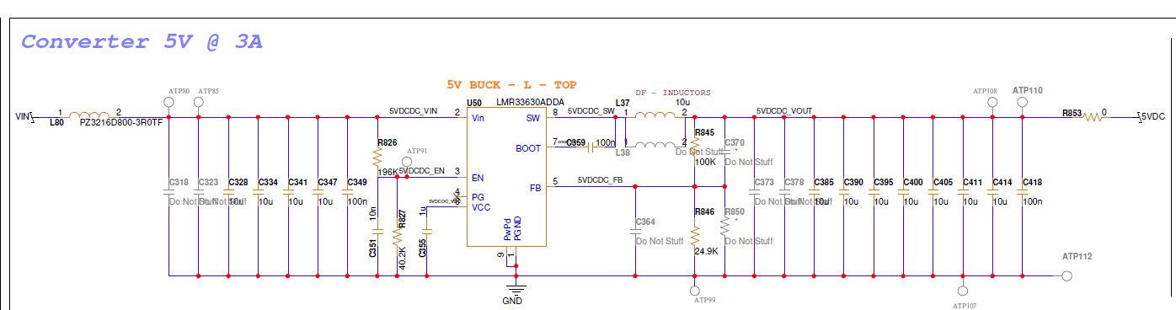
AP1999B portia X
Vin=10V-14V
Vo=5V
Po=15W

Slide 8
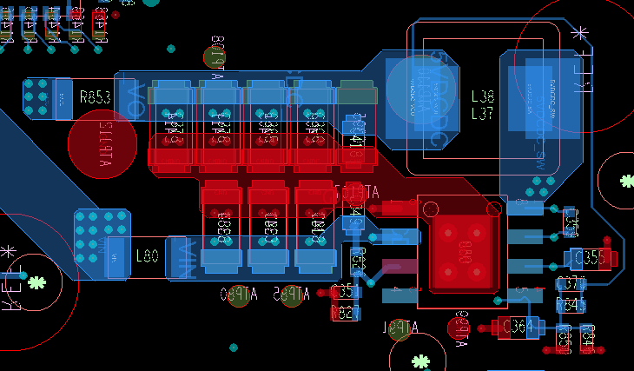
AP1999A portia X
Low Freq cap
FB path. Should take from output cap
High Freq cap
GND
SW
Bootstrap cap
Vin
LF cap
HF cap

Slide 9
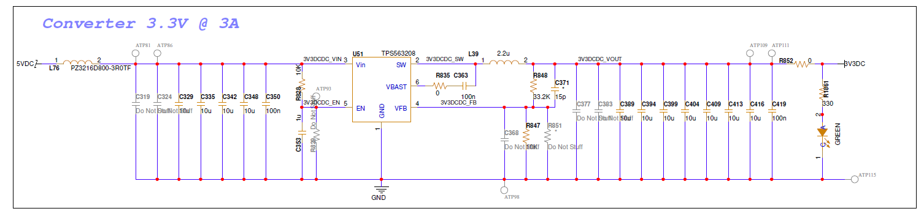
AP1999B portia X
Vin=4.5V-5.5V
Vo=3.3V
Po=10W.

Slide 10
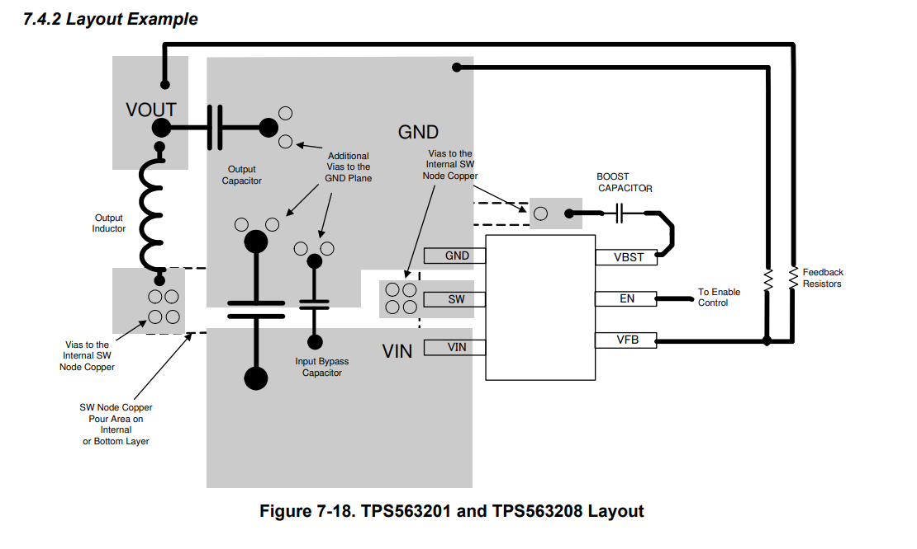
SW pin with Via’s

Slide 11
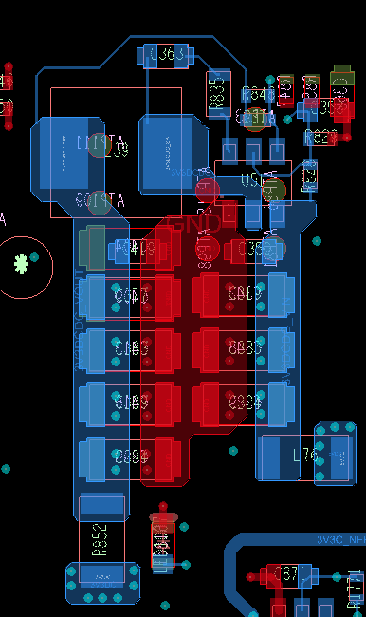
AP1999B portia X
SW pin directly to the inductor. Tradeoff between SW net under the device Vs short path to input capacitor

Slide 12
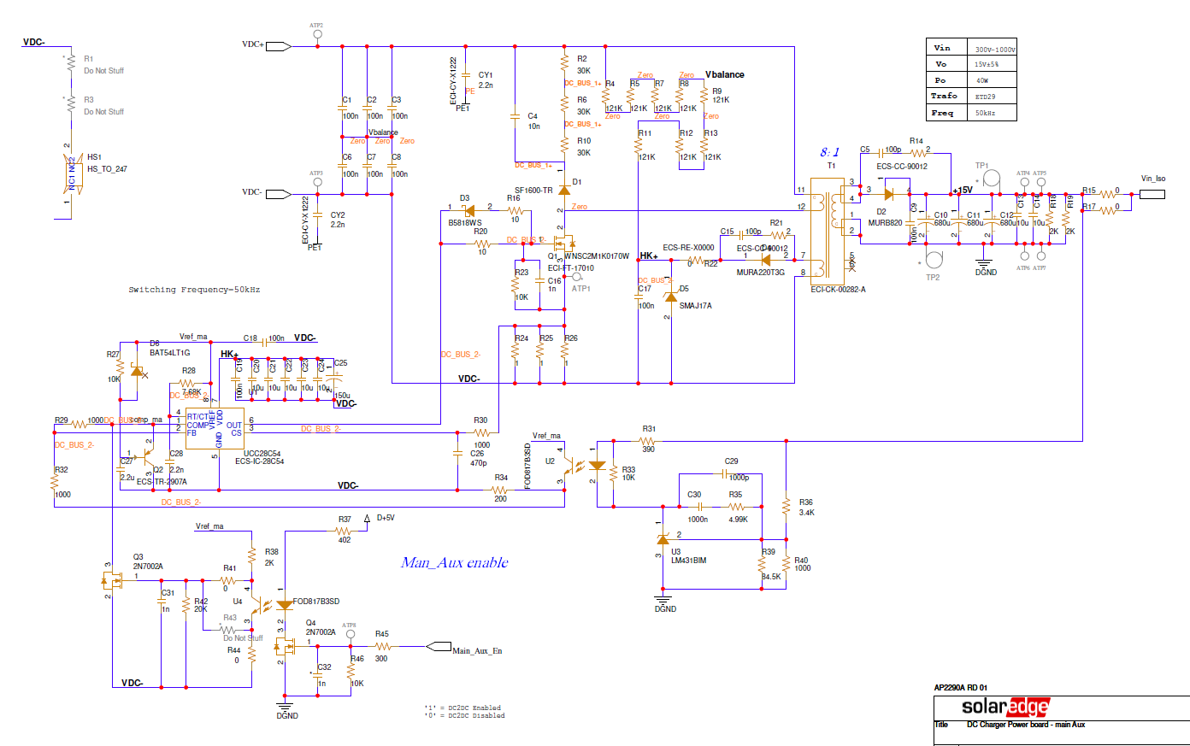
AP2290A Neptune main board, Vin=300V-1000V, 40W, 15V

Slide 13
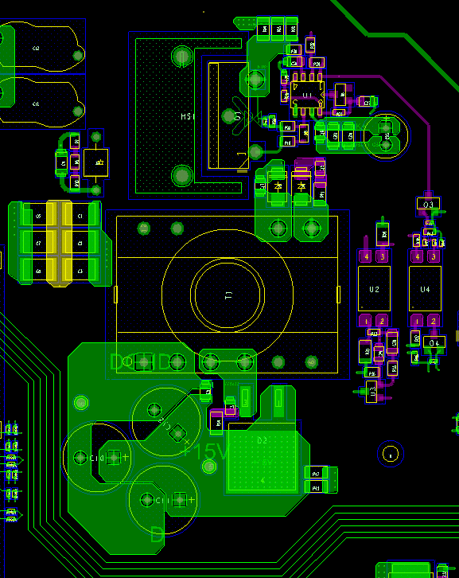
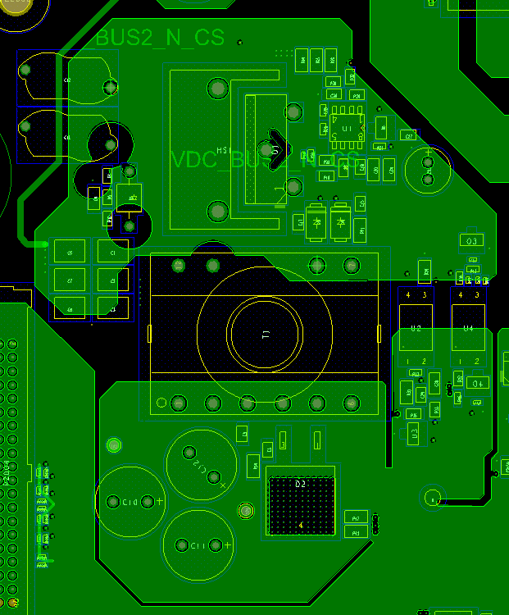
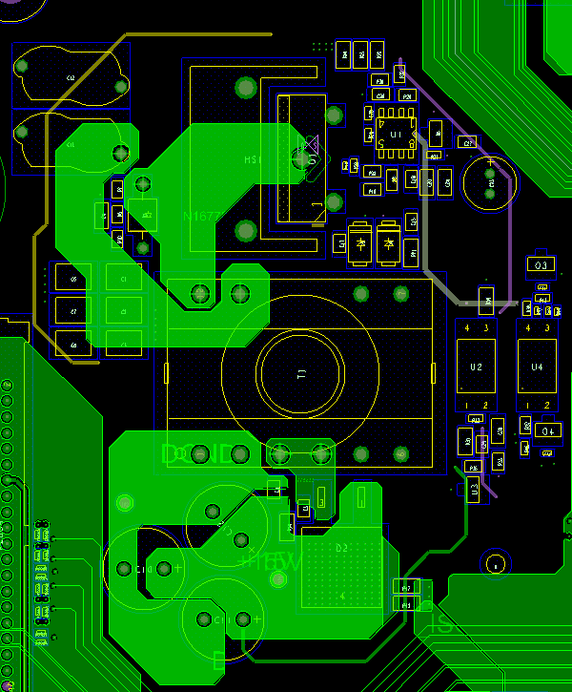
AP2290A Neptune main board
Don’t route signals under heatsink. Option for connect heatsink to DC+ or DC-. L1
Separated ground, and slots for power area and sensitive analog area. L2
Sense Voltage outside of the power area. L3,L5
Voltage sense

Slide 14
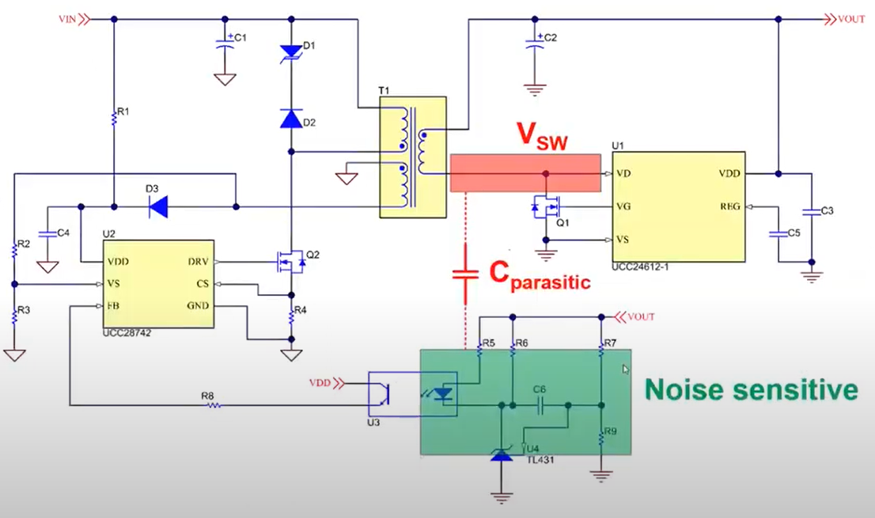
Cdv/dt parasitic. Make separate surfaces no overlap.

Slide 15
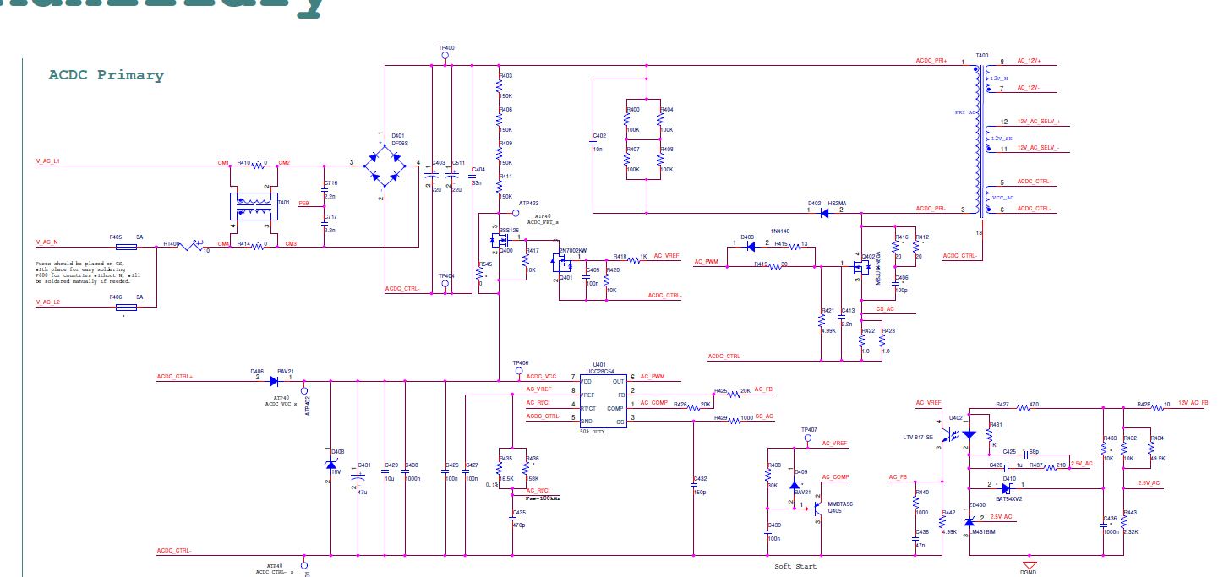
AP2214BA main board Jupiter 3, Total 30W: AC to 12V 15W, 12V SELV 15W

Slide 16
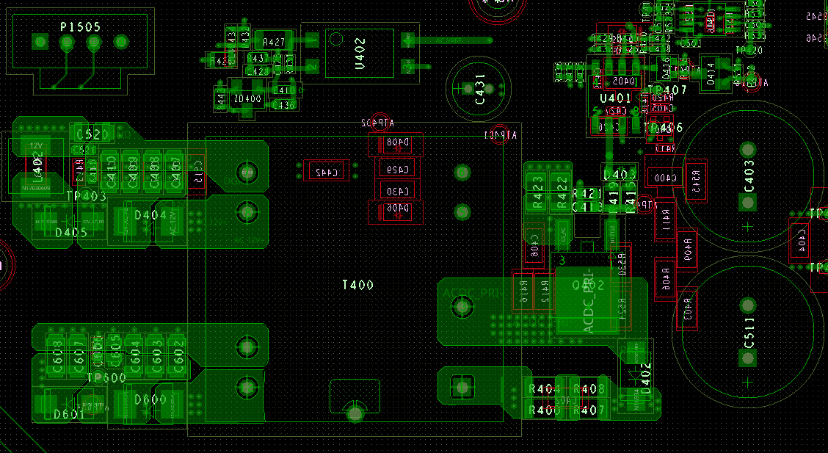
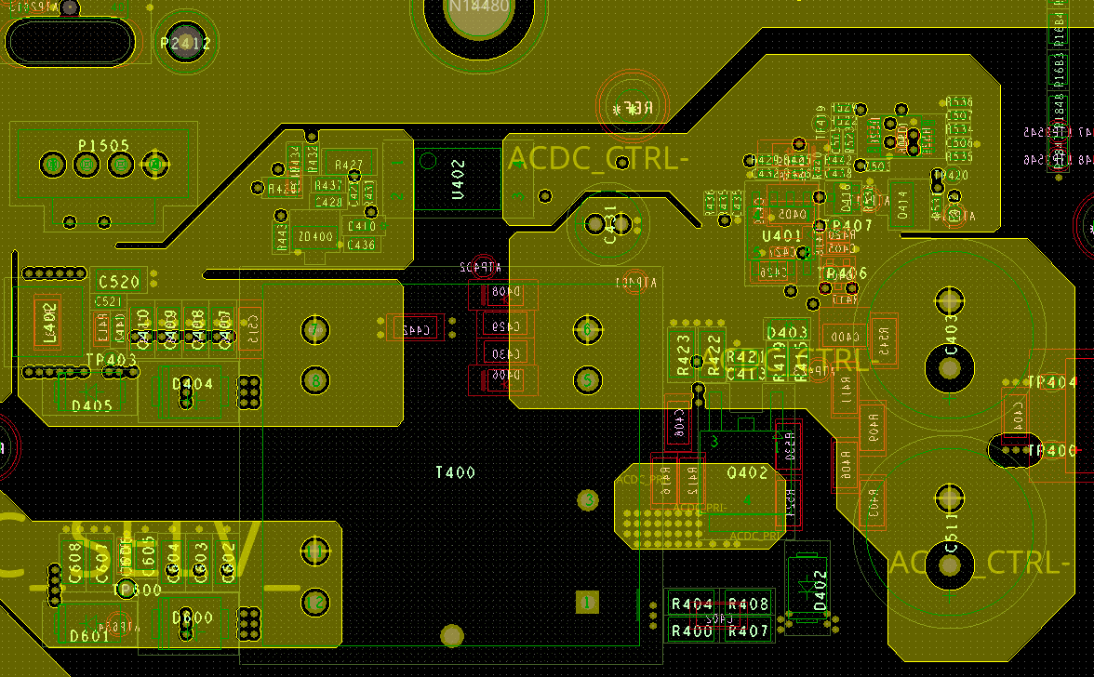
AP2214BA main board Jupiter 3, Total 30W: AC to 12V 15W, 12V SELV 15W
L2
Sense voltage
L1
Better not to put components on the bottom under the transformer. . Due to layout limitations we put it there
Power area

Slide 17
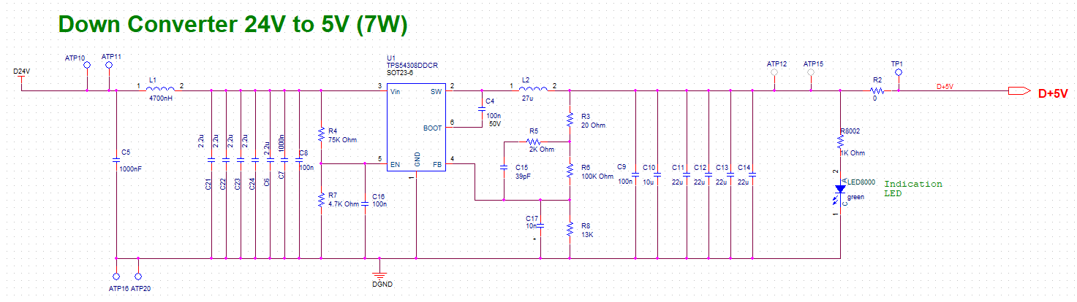
AP1391CA Orion Digital board, 5V, 1.4A, 7W

Slide 18
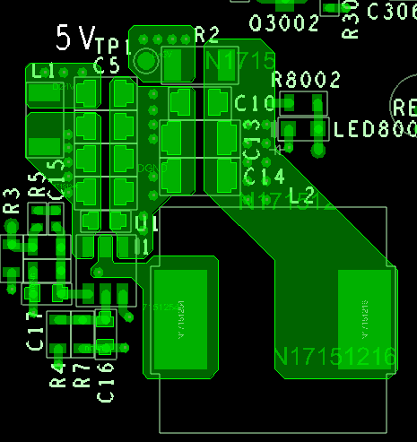
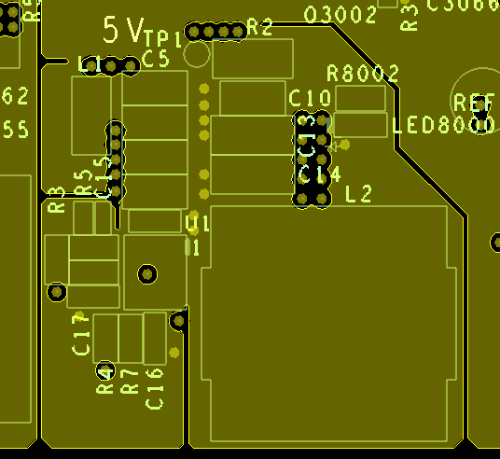
AP1391CA Orion Digital board, 5V, 1.4A, 7W
L1
SW pin is connected directly to the inductor
L1
Power ground is with slot to sensitive ground

Slide 19
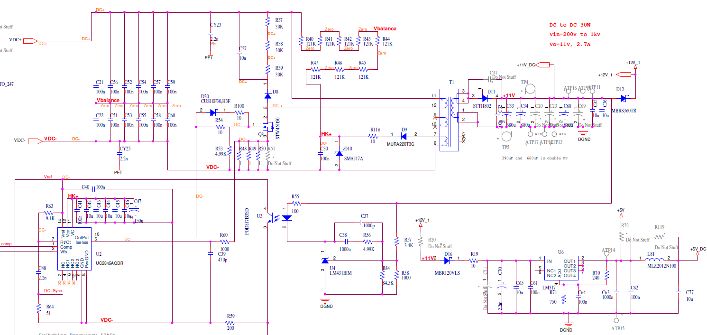
Jupiter + Improved DC board AP1163FB, 40W, input 350V-1000V, output 12V
Keep current loop as small as possible
Keep current loop as small as possible
Diode snubber better be on same side of the diode

Slide 20
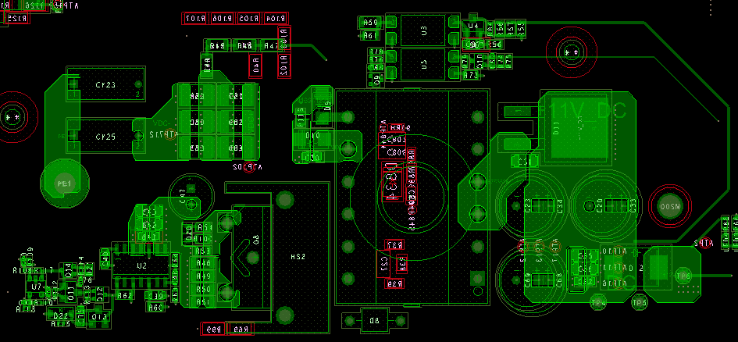
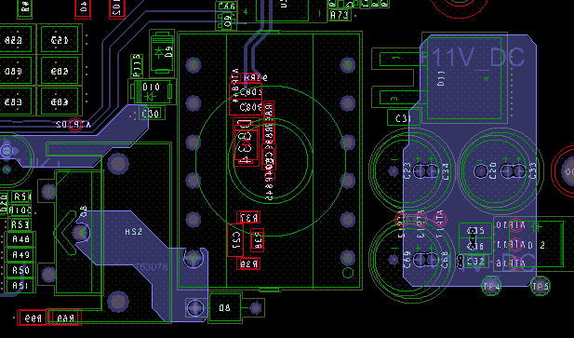
Jupiter + Improved DC board AP1163FB, 40W, input 350V-1000V, output 12V
Sensitive voltage need to be outside of power area
Keep current loop as small as possible. Layer 1
Keep current loop as small as possible. Layer 3

Slide 21
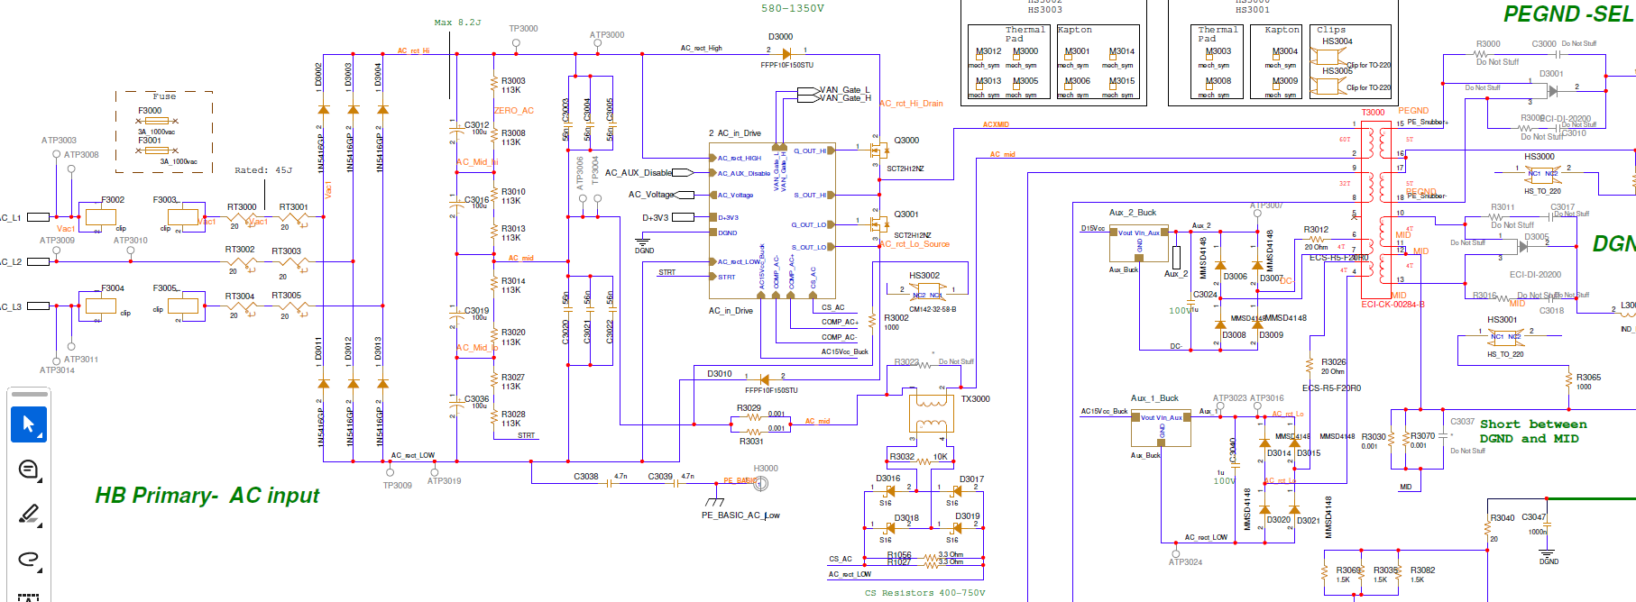
AP1551C Aux board Orion 690V/600V. 250W, 80W at DGND, 170W at SELV
Keep current loop as small as possible
Output diodes
Diode bridge
Input caps
NTC resistor
Heatsink
Fuse
Main trafo
Current sense trafo
Input Fets

Slide 22
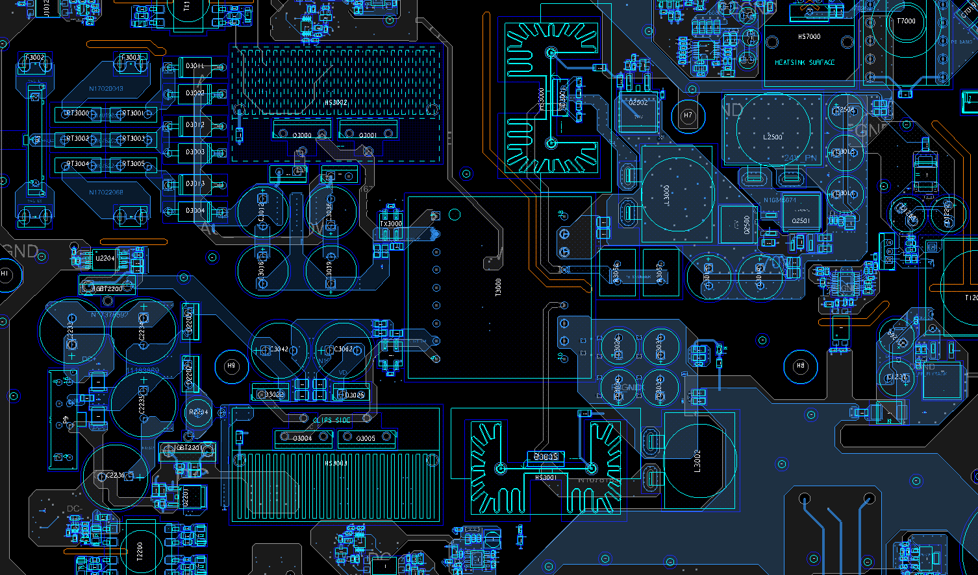
AP1551C Aux board Orion 690V/600V
Keep current loop as small as possible
DC SELV Diode
Diode bridge
Output inductor
24V Buck
AC main FET
Divider
Output capacitors
DC main FET
DC DGND Diode

Slide 23
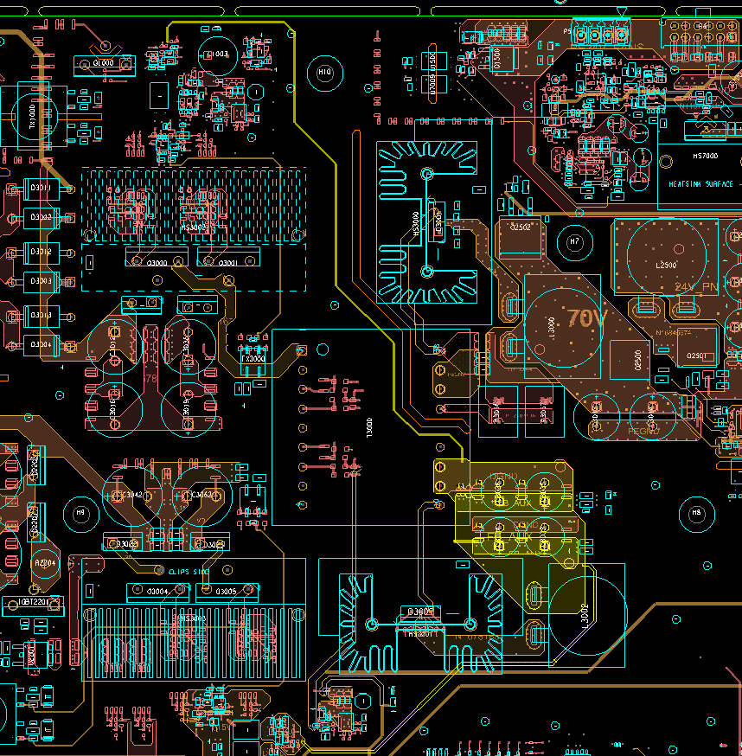
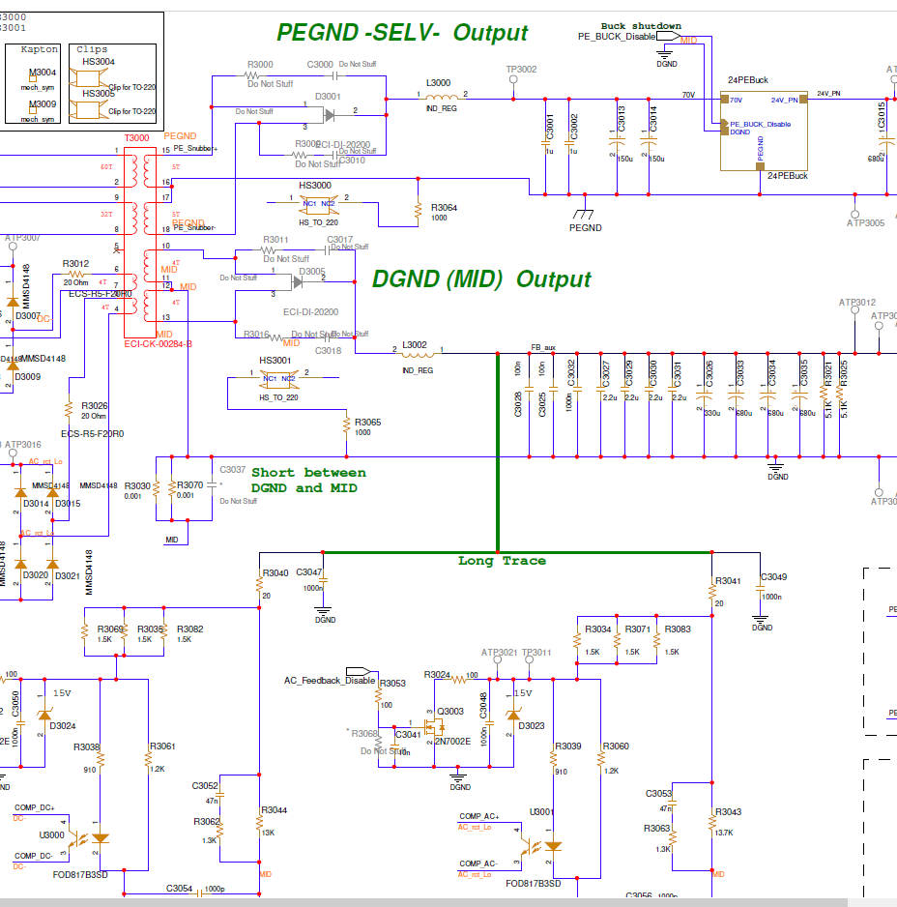
AP1551C Aux board Orion 690V/600V
Heatsink can be grounded or through resistor
Sensitive voltage should to be outside of power area prefer not under transformer. If needed put in internal layer with shielding.
AC opto coupler

Slide 24
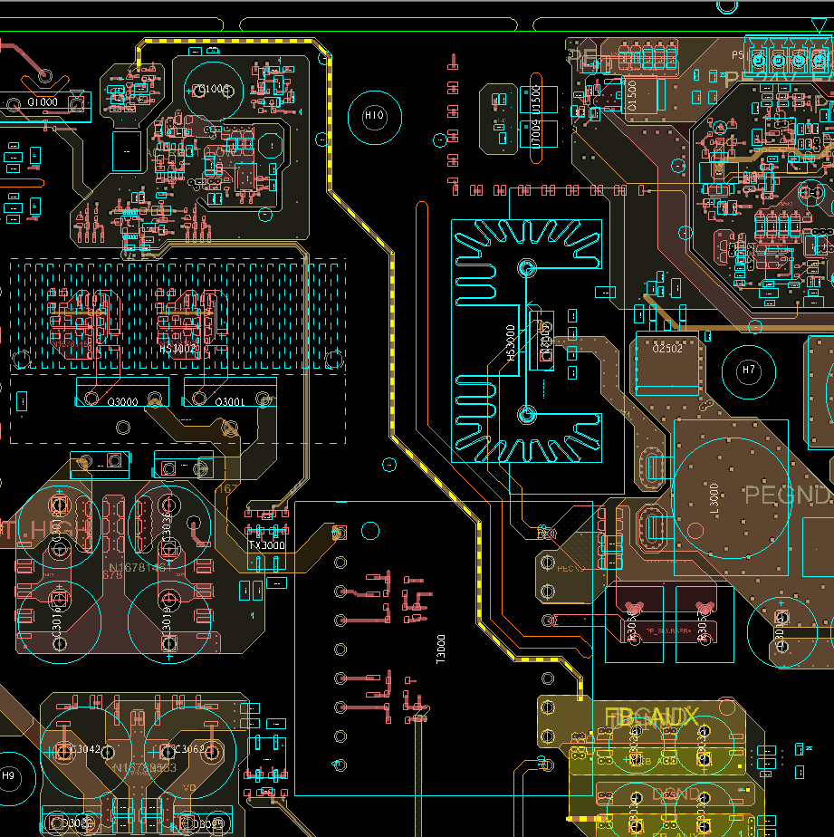
AP1551C Aux board Orion 690V/600V
Sensitive voltage under DGND in adjacent Layers

